Slide 1
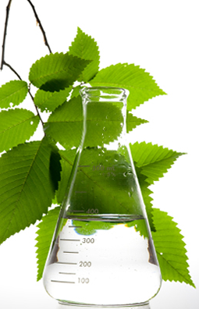
GREEN CHEMISTRY
Dr.JEENA.V.R
ASSISTANT PROFESSOR
DEPARTMENT OF CHEMISTRY
N S S COLLEGE, PANDALAM,KERALA

Slide 3
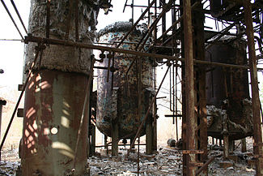
Bhopal Gas Tragedy A plant accident in Bhopal, India, released methyl isocyanate. Nearly 20000 people died.

Slide 4
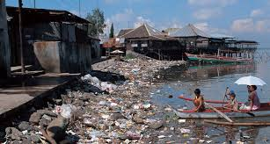
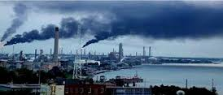
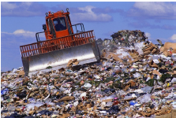
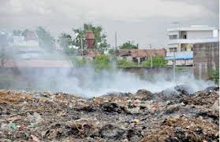

Slide 5
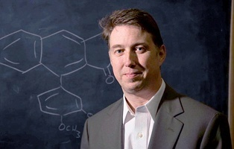
PAUL ANASTAS
Father Of Green Chemistry

Slide 7
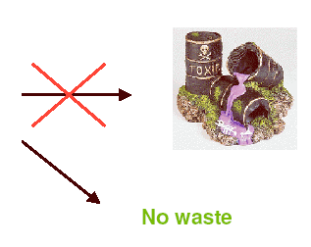
The 12 Principles of Green Chemistry
1. Prevention
It is better to prevent waste than to treat or clean up waste after it has been created.
Chemical
Process

Slide 8
The 12 Principles of Green Chemistry
2. Atom Economy
Synthetic methods should be designed to maximize the incorporation of all materials used in the process into the final product.

Low atom economy
+
+
Raw materials
Waste
(by-products)
Product

High atom economy
+
Raw materials
Product

Slide 9
The 12 Principles of Green Chemistry
3. Less Hazardous Chemical Syntheses
Wherever practicable, synthetic methods should be designed to use and generate substances that possess little or no toxicity to human health and the environment.

Less hazardous reagents and chemicals

When possible, toxic or hazard chemicals can be replaced by safer ones

Designing products that are safe and non-toxic, preserving their function
Notes:
9

Slide 10
The 12 Principles of Green Chemistry
Designing Safer Chemicals:
Chemical products should be designed to effect their desired function while minimising their toxicity.
Chemical products should be designed to effect their desired function while minimizing their toxicity.

Slide 11
The 12 Principles of Green Chemistry
Safer Solvents & Auxiliaries:
The use of auxiliary substances (e.g., solvents or separation agents) should be made unnecessary whenever possible and innocuous when used.

Slide 12
The 12 Principles of Green Chemistry
Design for Energy Efficiency:
Energy requirements of chemical processes should be recognised for their environmental and economic impacts and should be minimised. If possible, synthetic methods should be conducted at ambient temperature and pressure.
This can be achieved by
Use of proper catalyst , enzymes
Use of micro organisms for organic synthesis
Use of renewable materials

Slide 13
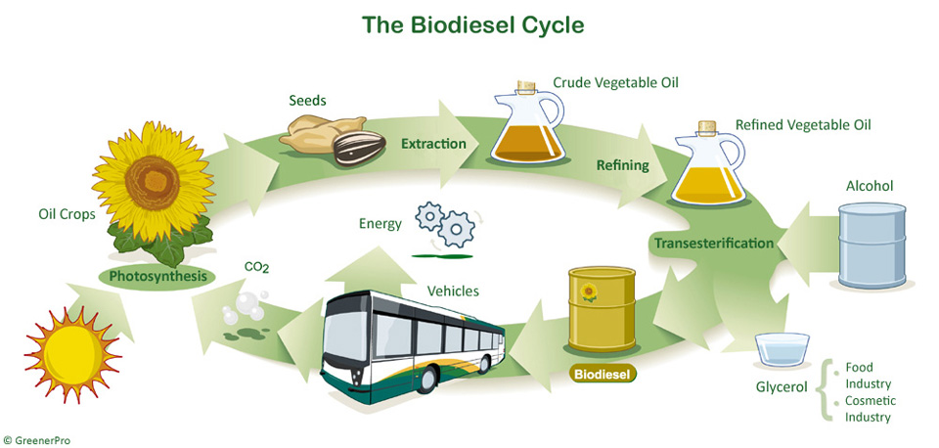
The 12 Principles of Green Chemistry
Use of Renewable Feedstock:
A raw material or feedstock should be renewable rather than depleting whenever technically and economically practicable.

Slide 14
The 12 Principles of Green Chemistry
Reduce Derivatives:
Unnecessary derivatization (use of blocking groups, protection/de-protection, and temporary modification of physical/chemical processes) should be minimised or avoided if possible,
such steps require additional reagents and can generate waste and atom economy is also reduced.

Slide 15
The 12 Principles of Green Chemistry
Catalysis:
Catalytic reagents (as selective as possible) are superior to stoichiometric reagents.
Catalysts make the
reaction faster
decrease the energy requirement
can produced single desired product
minimize waste.

Slide 16
The 12 Principles of Green Chemistry
Designing of Degrading Products:
Chemical products should be designed so that at the end of their function they break down into innocuous degradation products and do not persist in the environment.
Examples:
biodegradable polymer
natural insecticides

Slide 18
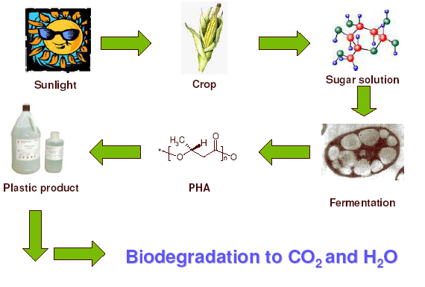
Polyhydroxyalkanoates (PHA’s)

Slide 19
The 12 Principles of Green Chemistry
Real Time Analysis for Pollution Prevention:
Analytical methodologies need to be further developed to allow for real-time, in-process monitoring and control prior to the formation of hazardous substances.

Slide 20
The 12 Principles of Green Chemistry
Safer Chemicals for Accidents Prevention:
Analytical Substances and the form of a substance used in a chemical process should be chosen to minimise the potential for chemical accidents, including releases, explosions, and fires.

Slide 21
Green Chemistry Is About...
^{Waste}
^{Materials}
^{Hazard}
Reducing
^{Risk}
Energy
Cost

Slide 22
Conclusion
Green chemistry is Not a solution to all environmental problems But the most fundamental approach to preventing pollution.

